Slide 1
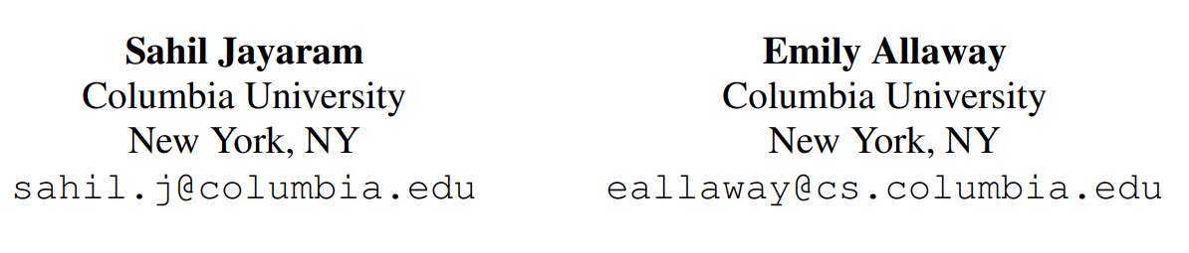
Human Rationales as Attribution Priors for Explainable Stance Detection
ACL November 2021
Presenter : Guo Zikun

Slide 2
Contents
Introduction
Method -Mean attention weights (MAW).
Result
Conclusion

Slide 3
Introduction
As NLP systems become better at detecting opinions and beliefs from text, it is important to ensure not only that models are accurate but also that they arrive at their predictions in ways that align with human reasoning.
Imparting human-like rationalization to a stance detection model using crowdsourced annotations on a small fraction of the training data.
Improve the reasoning of a state-of-the-art classifier
Attention weights surpass a leading attribution method in providing faithful explanations of our model’s predictions,
Notes:
随着 NLP 系统在从文本中检测观点和信念 方面变得越来越好，重要的是不仅要确保 模型是准确的，而且要确保它们以符合人 类推理的方式来实现预测。
将类似人类 的合理化传递给姿态检测模型
我们的方法可 以提高最先进的分类器的推理能力
注意力权重在提供模型预测的可靠解释方 面优于领先的归因方法

Slide 4
Stance detection
Stance detection, :
Automatically identifying the position on a topic taken by a text. allows readers to glean valuable information from news articles and social media, such as whether the writing is politically slanted.
Sensitivity
Stand model transparent
predictions in human-like ways.
Notes:
姿态检测，：
自动识别文本在主题上的位置。 允许读者从新闻文章和社交媒体中收集有价值的信息，例如文章是否带有政治倾向。
灵敏度
支架模型透明
以类似人类的方式进行预测。

Slide 5
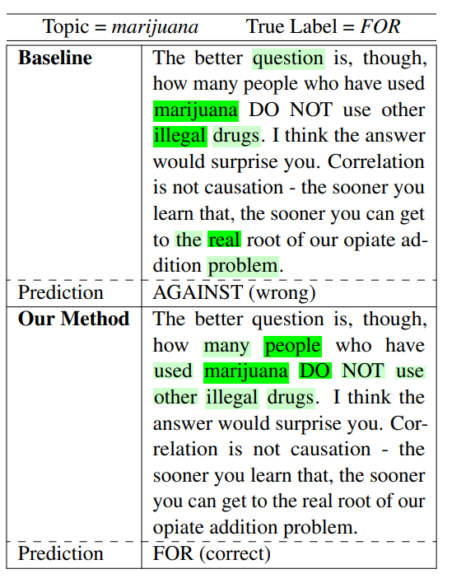
Mean attention weights (MAW).
Model reasoning as explained by mean attention weights (MAW). The baseline is trained using only cross-entropy loss, while the second model is trained using our proposed attribution prior.
Notes:
由平均注意力权重 (MAW) 解释的模型推理。 基线仅使用交叉熵损失进行训练，而第二个模型使用我们提出的先验归因进行训练。

Slide 6
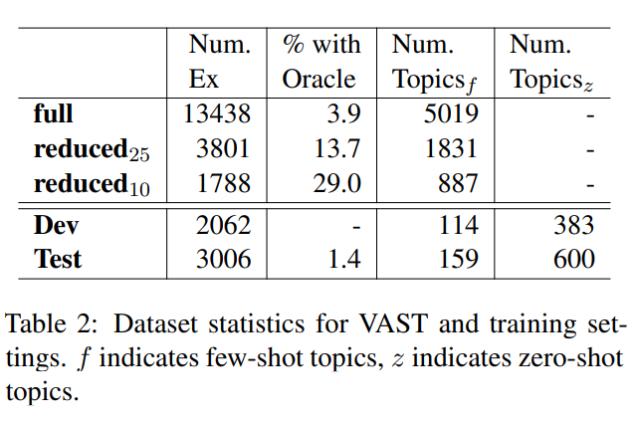
Dataset : Crowdsourcing Annotation
Annotate a portion of the recently proposed VAST:
Identifying important noun-phrases
validated (or corrected) using crowdsourcing “pro” (for), “con” (against), or “neutral.”
Randomly select from the train set 700 non-neutral examples whose topics were validated by annotators. Also select 75 such examples from the test set.
Notes:
这是如何组成的数据集

Slide 7
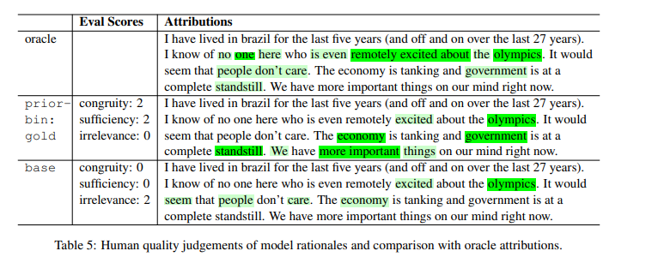
Dataset : Crowdsourcing Annotation
Computation and Processing:
disregard a worker’s annotations for an example if their stance classification disagrees with the label. Our oracle attributions are a weighted sum of annotator responses, with worker quality score (WQS) as the weighting factor. （WQS measures an annotator’s word-level agreement with their peers ）
Analysis:
Processed oracle attributions and observe that annotators mark an average of 26% of the tokens in an argument as important. Words from the topic are only selected for 51% of the examples while an average of 44% of important words are stopwords.
e.g.
selected “no one here” in the sentence “I know of no one here who is even remotely excited about the olympics” . This shows that human word importance judgements cannot be approximated simply by selecting the topic or the words most similar to the topic.
Notes:
这是如何组成的数据集

Slide 8
Methods
Architecture:
Define D = {x_{i} = (d_{i} , t_{i} , y_{i})} N_{i}=1 as a dataset with N examples, each consisting of an argument d_{i} , a topic t_{i} , and a stance label y_{i} ∈ {0, 1, −1}. In addition, let M_{θ} be some model with parameters θ. Then we can define for each example x a set of oracle attributions S, model attributions a, and penalty weights γ (the contribution of each token to our loss term).
Feature Attribution : Mean Attention Weights (MAW)
Extremely low computational cost in comparison with other methods, most of which require backpropagation and/or multiple forward. In MAW, the attribution score of token j is the mean, taken across all tokens, layers, and attention heads, of attention weights α_{ij}
Notes:
这是如何组成的数据集

Slide 9
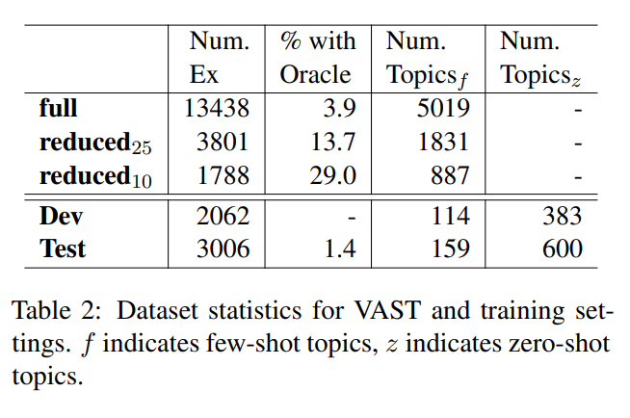
Experiments
Data:
Train and evaluate on VAST, using the standard train/dev/test split and both subsets of the test set: few-shot (few training examples per test topic) and zero-shot (no training or development examples per test topic).
Notes:
这是如何组成的数据集

Slide 10
Model
Train a stance model (prior-bin:gold) with our proposed attribution prior, by using
Binary penalty weights : In order to exclude certain tokens (punctuation and numerals) from our rationale loss function, and to potentially assign non-uniform influence to the remaining tokens, we introduce the notion of penalty weights. Crowdsourced oracle attributions. The penalty weight of a token specifies its contribution to the rationale loss function. In experiments, focus primarily on binary penalty weights, where tokens that are punctuation marks or numerals receive a score of 0 and all other tokens receive a score of 1.
MAW to extract model attributions : its extremely low computational cost in comparison with other methods, most of which require backpropagation or multiple forward passes . In MAW, the attribution score of token j is the mean, taken across all tokens, layers, and attention heads, of attention weights αij—that is, all attention weights associated with the key at index j.
Notes:
这是如何组成的数据集

Slide 11
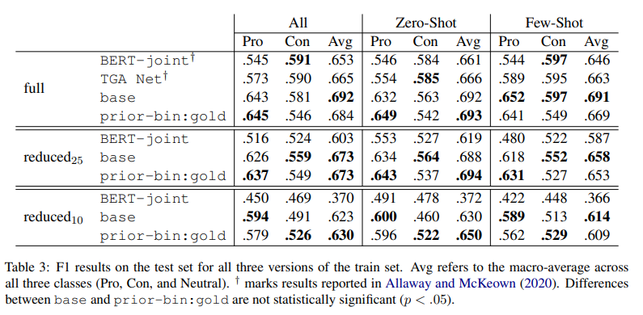
Results: Stance Prediction
Prior-bin:gold and base achieve comparable results and outperform the baselines proposed for VAST：
.Therefore, our stance prediction results show that human word importance annotations are necessary in order to obtain strong results using our proposed attribution prior.
Notes:
这是如何组成的数据集

Slide 12
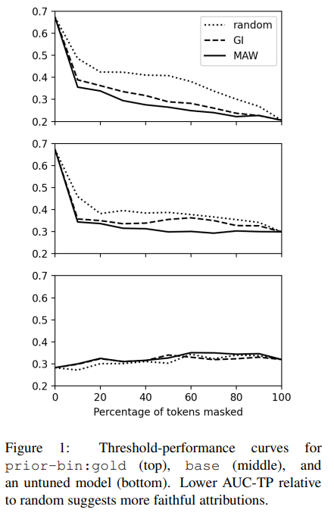
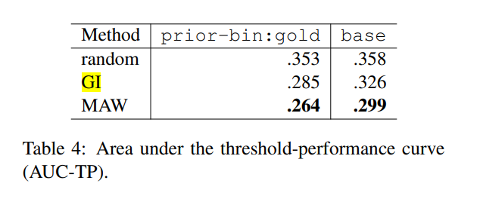
Results: Analysis of Rationales
Relative reliability of explanations obtained from MAW and GI by using two separate mechanisms:
human raters
Rationale loss function (MAW Rationale loss function ).
MAW surpasses GI in faithfulness for both prior-bin:gold and base and considerably outperforms random attributions：
MAW attributions are faithful to our model , and can be trusted
We can justifiably interpret MAW attributions as rationales.
Notes:
这是如何组成的数据集

Slide 13
Conclution
This paper addresses two issues concerning the task of stance detection:
The need for models whose reasoning aligns with that of humans
The need for a way to meaningfully observe the reasoning of models in the first place.
Improves model rationales using a practical volume of crowdsourced annotations -- Attention-based explanations
Meaningfully improve model reasoning — Guided Backpropagation and LIME
Notes:
这是如何组成的数据集

Slide 14
THANKS
Notes:
这是如何组成的数据集

